Slide 1
FY2019 Visioning Process
Council Work Session - January 22, 2018

Slide 2
Visioning as Part of the Budget Process
FY19 is the second year of the budget cycle. Intent for budget review this year is to focus on Economic Updates to Plan, Changes to Plan, and Horizon Issues.
Using the Work Sessions in 2018 for “visioning” will enable us to focus on developing financial, technical, and structural approaches to ensure sustainable quality of life for the community.
The Resident Satisfaction Survey will be performed this summer and will be a significant input to the FY20 budget process.
The end goal is to create an agile and accountable organization that is focused on community goals and values.

Slide 3
Visioning Schedule
DATE | TOPIC
January 22 | Protecting and Serving – Public Safety
February 12 | Setting the Stage – Legislative Updates and Policy Agenda Development
February 26 | Reserved for budget purposes, if necessary
March 12 | FY2019 Budget and Cost of Services/Rates
April 9 | Building for Tomorrow – Infrastructure Priorities and Projects
May 14 | Ensuring an Inclusive Community – Equity and Housing
June 11 | Providing a Healthy A2 – Parks and Recreation, Health, and Sustainability
September 13 (Thurs) | Being a Better Business Partner – Economic Development and Competitiveness
October 8 | Enhancing the Vibrancy of Our Downtown – Joint Meeting with DDA
December 10 | Securing the Financial Future – FY2020 Budget Kick-Off
NOTES: Council does not normally schedule Work Sessions during the summer months (July/August) or during November. However, these months are available at Council’s discretion.

Slide 4
Engaging the Community
As part of each of the sessions, the staff lead will work with our Communications Office to gather information via surveys, social media input, meetings, and other methods.
Input will be used to form the content of each session, and to develop questions for the Resident Satisfaction Survey scheduled for this summer.
Council Members are encouraged to help shape the discussions by identifying the areas in which they would want input, and by working with staff in advance of the sessions to form questions and obtain feedback.

Slide 5
“Protecting and Serving”
Visioning Public Safety
Council Work Session - January 22, 2018

Slide 6
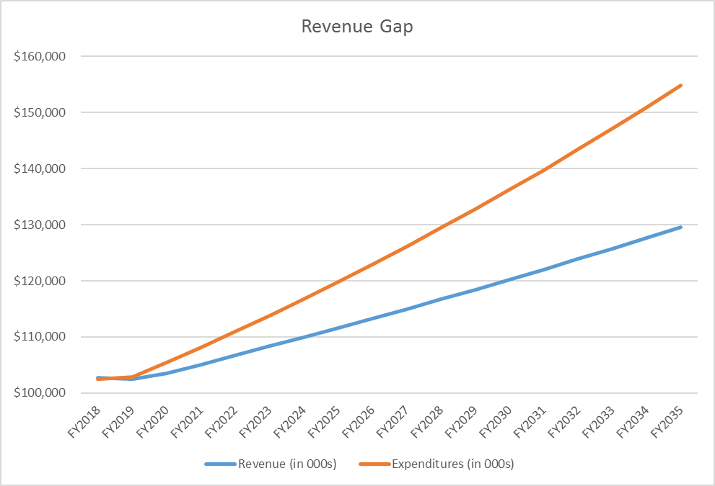
Projected General Fund Growth
Revenue rate of growth: 1.6%
Expense rate of growth: 2.6%
Personnel expenses: 65%
Current FY20 gap: $1.18MM
Projected FY35 gap: $25MM

Slide 7
The Cost of Public Safety
Element | FY2016 Actual | FY2017 Actual | FY2018 Forecast | FY2019 Projected
Police and Fire Revenues | $ 4,060,415 | $ 4,297,227 | $ 3,931,218 | $ 4,031,218
Police and Fire Expenditures | 41,174,102 | 42,523,532 | 42,447,669 | 44,602,155
Total Net Recurring Expenditures | $37,113,687 | $38,226,305 | $38,516,451 | $40,570,937
Total General Fund Recurring Expenditures | $73,403,484 | $76,238,989 | $78,991,261 | $81,646,237
% of General Fund | 51% | 50% | 49% | 50%
Total Public Safety Staffing (FTE) |  |  |  | 236/740
Total City General Fund Staffing (FTE) |  |  |  | 382
% of Total Staffing (FTE) |  |  |  | 62%

Slide 8
Fire Department Update

Slide 9
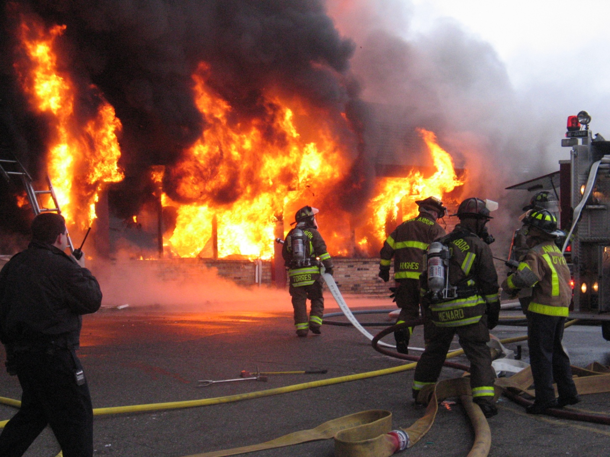
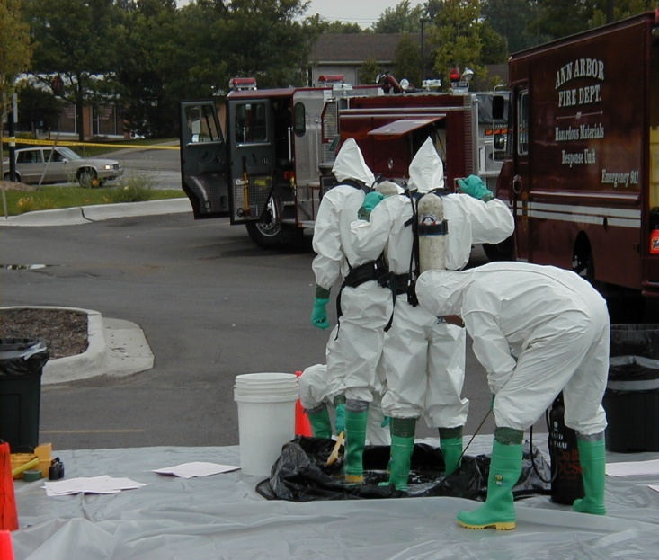
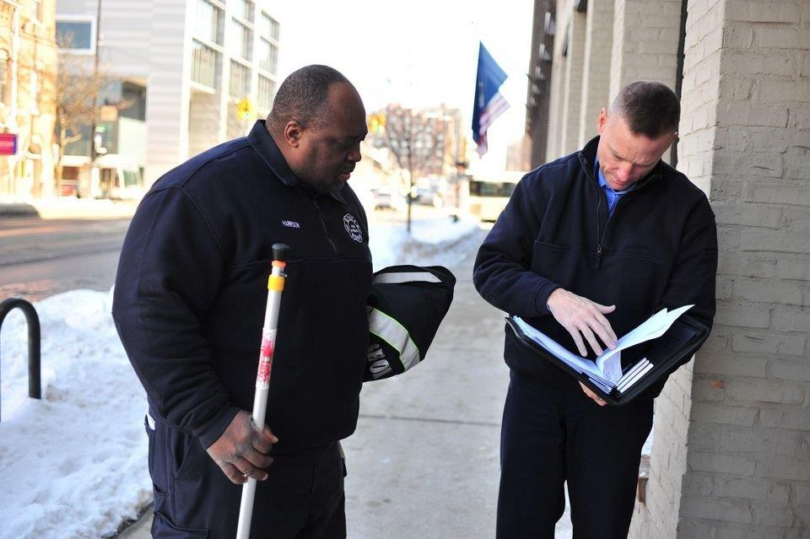
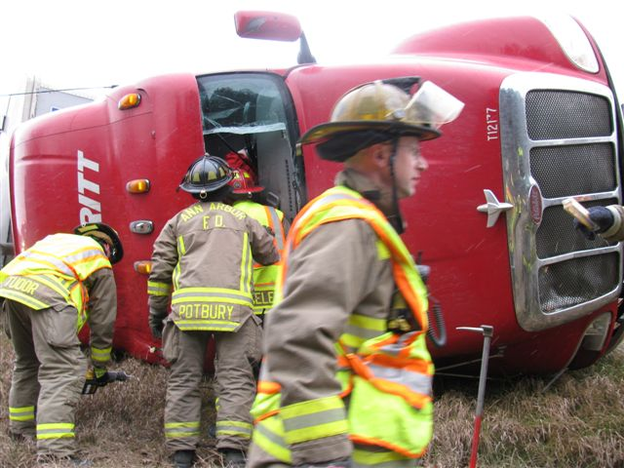
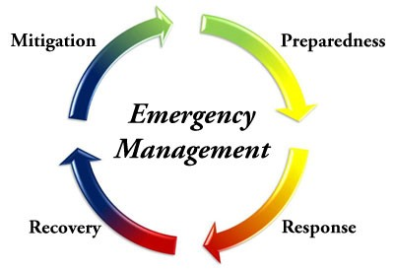
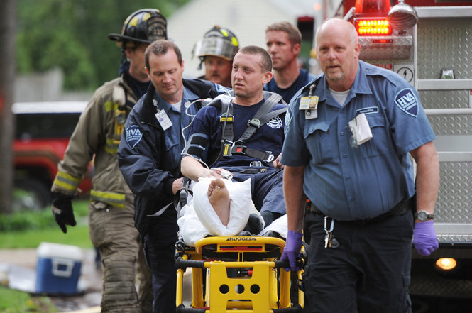
AAFD Core Services
Fire Suppression
Hazmat Response
Fire Prevention
Technical Rescue
Emergency Management
EMS 1st Responder

Slide 10
AAFD Response Categories (Jan-Oct 2017)
Data is consistent with 2014-2016 totals
All Others include Good Intent, Severe Weather, and Other Incident Types
Fire/Explosion/Hazardous includes False Alarms

Slide 11
AAFD Performance Measures – Fire Suppression/ EMS 1st Responder/HAZMAT/Other
Scope of Service: Provide timely and professional fire and EMS response to fire and MES response to fire, explosion, EMS, HAZMAT, and technical rescue emergencies occurring within the City of Ann Arbor to reduce damage to life and property in the city.
2017 Performance Goals | 90th Percentile Criteria | 1Q | 2Q | 3Q | STATUS
Turnout Time | EMS National Standard – 1:00 Minute | 2:36 | 2:36 | 2:34 | l
 | FIRE National Standard – 1:20 Minutes | 3:11 | 3:14 | 2:40 | l
Travel Time | EMS National Standard – 4:00 Minutes | 5:59 | 5:53 | 6:05 | l
 | FIRE National Standard – 4:00 Minutes | 9:55 | 9:22 | 10:15 | l
Combined Time | EMS National Standard – 6:00 Minutes | 7:54 | 8:41 | 7:45 | l
 | FIRE National Standard – 6:20 Minutes | 12:00 | 12:20 | 11:48 | l
Effective Response Force | FIRE National Standard – 8:00 Minutes | 33.0% | 50.0% | 20.0% | l
 | Total Reported ERF Incidents | 6 | 8 | 5

Slide 12
AAFD Performance Measures – Emergency Management
Scope of Service: Provide for the planning, mitigation, and coordination of response and recovery from natural and human made emergencies and disasters occurring in the City of Ann Arbor.
MEASURE/ACTION | GOAL | STATUS
Revise Chapter 15 (Emergency and Disaster Management) of the City Code to be consistent with State Statute requirements. | Submit and gain Council approval of revised Chapter 15. | l | Completed.
Re-write and update emergency operations plan. | Complete by July 30, 2017. | l | Completed.
Complete annual basic EOC & Plan refresher training for senior City staff and elected officials including table top exercises. | Complete by November 1, 2017. | l | Completed.

Slide 13
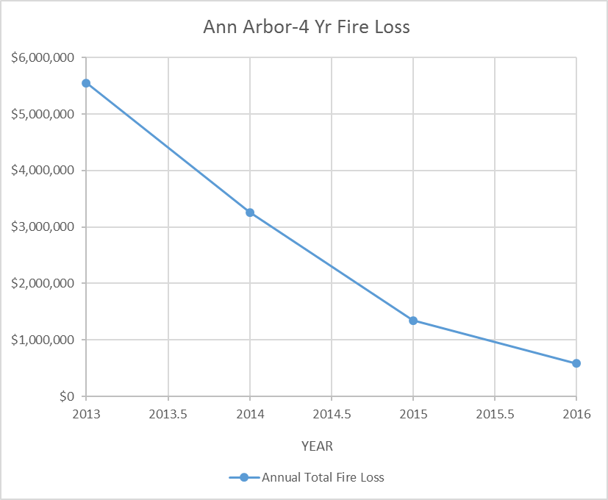
AAFD Performance Measures – Fire Prevention
Scope of Service: Prevent loss of life and property from the effects of unwanted fire and other emergencies within the City of Ann Arbor, reduce damage when such emergencies do occur.
GOAL | STATUS
Increase the number of fire inspections by 5% through the implementation of new technology and redistribution of assigned inspection districts | l | Increases in number and costs of inspections not meeting performance goals and not demonstrating positive trend.
Reduce value of damages. | l | Goal met – see chart.
Year Annual l Fire Loss
2016 $581,000
2015 $1,344,210
2014 $3,256,810
2013 $5,549,659

Slide 14
Other Ongoing AAFD Actions
Scope of Service: Implement high priority components of Fire Strategic Plan.
COMPONENT | STATUS
Fire Station Master Plan | l | Fire station plan in development.
Gain Department Accreditation | l | Accreditation behind schedule.
Increase diversity in recruiting | l | Work in progress.
Paramedic first responder training for engine/ladder companies by July 1, 2019 | l | Work in progress.

Slide 15
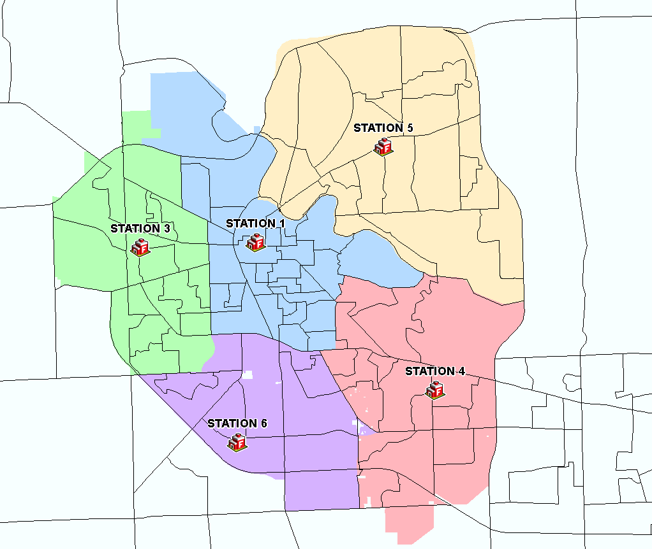
Fire Station Locations

Slide 16
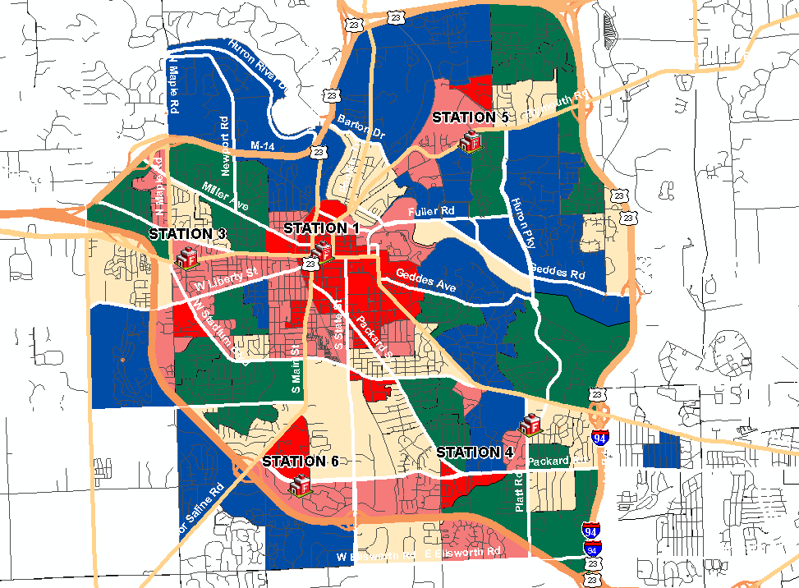
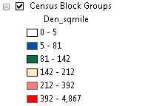
Fire Station Locations vs. Population Density

Slide 17
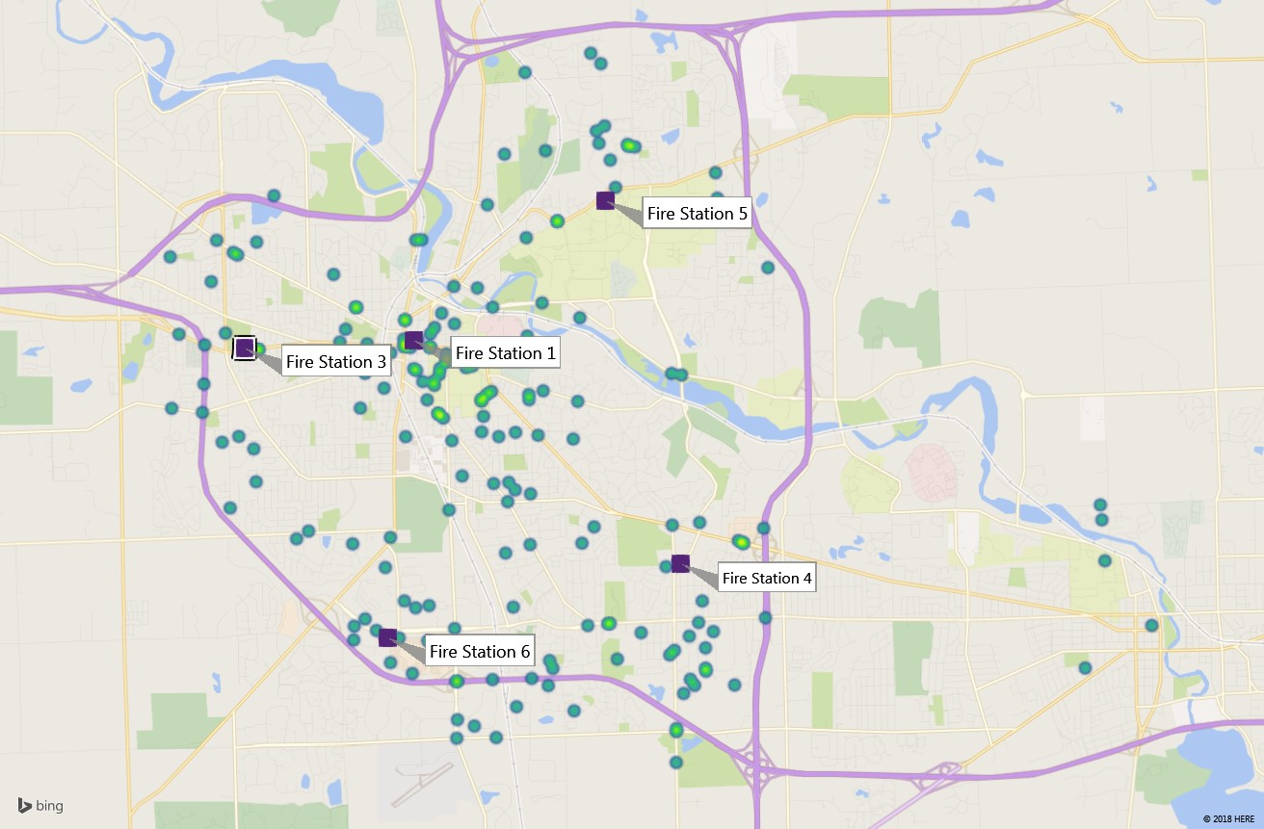
Fire Station Locations vs. Fire Calls

Slide 18
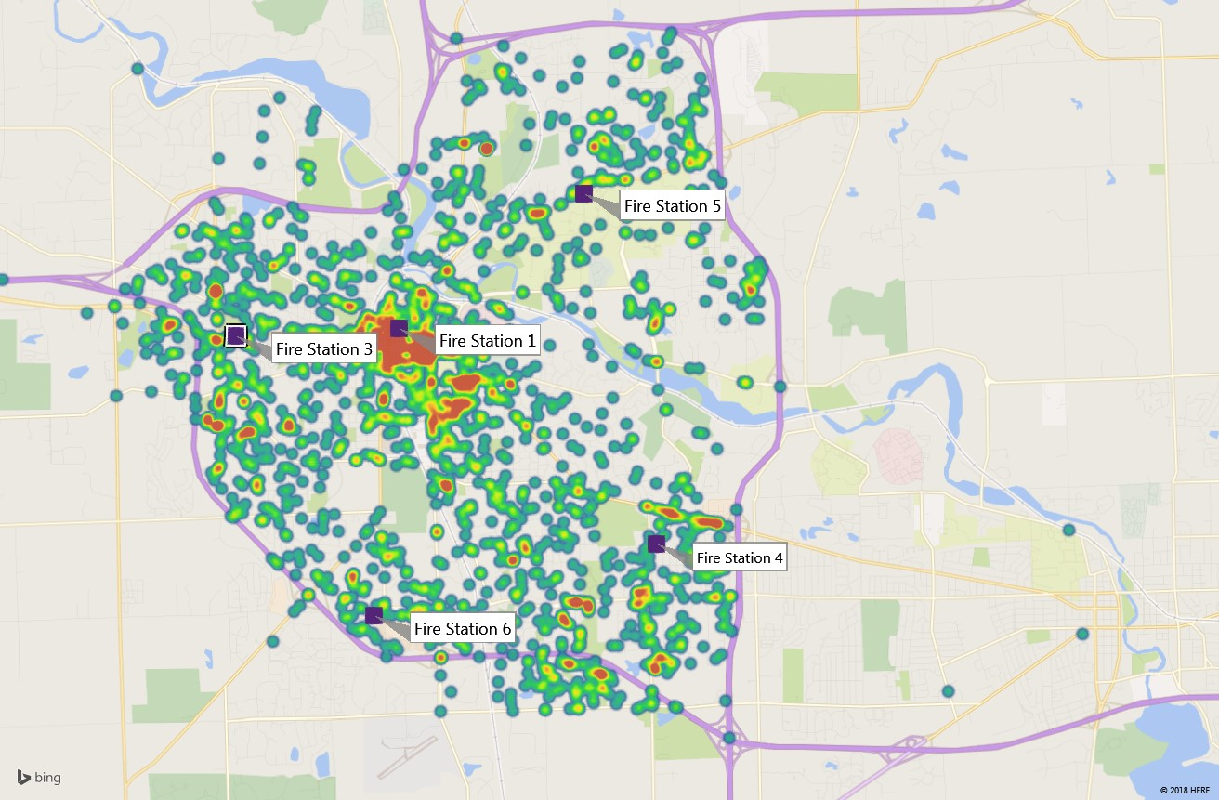
Fire Station Locations vs. Medical Calls

Slide 19
Components of AAFD Vision Implementation
Improvement needed in mapping emergencies to core services.
Improvements needed in response times. Dependent upon:
  Reliable and reproducible measurement of turnout and travel times.
  Improved mapping of time of day and location of calls.
  Crew training.
  Staffing model.
  Station locations.
Significant and measurable progress needed on components of strategic plan.
Implement cost of service capture and benchmarking.
  Changes needed to Public Acts 207 (Fire Inspection) and 312 (Compulsory Arbitration of Labor Disputes in Police and Fire Departments).

Slide 20
What is your vision for our Fire Department?

Slide 21
Police Department Update

Slide 22
HRC 2015 Report vs. Hillard Heintze (HH) Assessment
HRC HH
Engage the services of a police auditor-consultant on a temporary basis.
The scope of work for the review was developed in full partnership with a diverse group of stakeholder representatives.
Firms invited to participate included the firms identified in the HRC report.
The stakeholder group served as voting members in the review of the proposals, identification of the “short list” of respondents, and selection of the accepted proposal.
Hillard Heintze was the unanimous choice of the selection team.
Numerous opportunities were provided to gather community input.
Hillard Heintze’s final report met the requirements of its contract.

Slide 23
HRC 2015 Report vs. Hillard Heintze (HH) Assessment
HRC HH
Create an independent, all volunteer civilian police review board.
01 – Civilian Review – Co-Produced Policing Committee (7)
Implement use of alternative dispute resolution methods.
03 – Citizen Complaints and Discipline (9)
Consider implementing several other changes to the AAPD’s approach. Implement use of crisis intervention teams and community policing and engagement.
02 – Community Engagement (9)
04 – CALEA Implementation and Policy Review (3)
05 – Personnel Management Practices (7)
06 – Training (5)

Slide 24
AAPD Core Services
Patrol
Criminal Investigation
Traffic Safety
Parking Enforcement
Community Engagement

Slide 25
AAPD Performance Measures – Patrol
Scope of Service: Respond to emergency and quality of life calls; maintain visibility, and provide directed patrol.
GOAL | MEASUREMENT | STATUS
Citizen perception of safety is high. | Perception of Community Safety Survey (located on Department website) | l | In progress
No reports of non-availability for response to priority calls for services. | Washtenaw Metro Dispatch Computer Aided Dispatch data | l | Meeting
Staff morale is high and CBA’s are negotiated in a timely manner. | Annual Employee Survey and HR report out | l | In progress

Slide 26
AAPD Performance Measures – Criminal Investigation
Scope of Service: Investigate cases, collaborate with other law enforcement agencies, provide proactive drug enforcement, and perform cell phone forensics.
GOAL | MEASUREMENT | STATUS
100% felony criminal cases with a solvability factor* are assigned to a detective. | Records management and supervisor review | l | Meeting
All reasonable misdemeanor cases with a solvability factor* are assigned. | Records management and supervisor review | l | Meeting
100% of cell phones/computers associated with a case are analyzed. | Records management and supervisor review | l | Not yet meeting
*Solvability factors include witnesses to the crime, knowledge of a suspect’s name, knowledge of where a suspect can be located, description of a suspect, identification of a suspect, property with identifiable characteristics, a significant modus operandi, significant physical evidence, description of a suspect’s vehicle, positive results from a crime-scene evidence search, and belief that a crime may be solved with publicity or reasonable additional investigative effort.

Slide 27
AAPD Performance Measures – Traffic Safety
Scope of Service: Process traffic complaints, perform crash investigations, enforce traffic regulations.
GOAL | MEASUREMENT | STATUS
All traffic complaints are evaluated within one week of submission. | Traffic Complaint Survey | l | In progress
School zone complaints are assigned within 3 days of evaluation. | Traffic Complaint Survey | l | In progress
>99% of crossing guard locations are staffed. | Schedule tracking | l | Meeting

Slide 28
AAPD Performance Measures – Parking Enforcement/Community Standards
Scope of Service: Enforce parking, snow and ice, and vegetation ordinances.
GOAL | MEASUREMENT | STATUS
100% of complaints are assigned. | Records management and supervisor review | l | Meeting

Slide 29
AAPD Performance Measures – Community Engagement
Scope of Service: Conduct community meetings and Citizen’s Academy. Coordinate volunteers. Provide safety presentations. Conduct business visits.
GOAL | MEASUREMENT | STATUS
100% attendance rate for any community event/meeting where PD is requested. | Supervisor review and schedule tracking | l | Meeting
Citizen perception of approachability and police community trust is high. | Measured by the Resident Satisfaction Survey. | l | Meeting
100% of citizen complaints are investigated. | Records management and supervisor review | l | Meeting
PD social media footprint is expanded to include Twitter. | N/A | l | Complete
Safety Town and Citizen’s Police Academy are at capacity attendance. | Supervisor review and schedule tracking | l | Meeting

Slide 30
AAPD Updates - General
Deputy Chief of Support Services – Jason Forsberg has been hired.
Community Standards Officer vacancy will be posted soon.
Wellness Checks of Officers being launched.
AAPD is reviewing vehicle requirements in light of the revised Green Fleets policy.

Slide 31
01 – Civilian Review: Co-Producing Policing Commission
Task force being formed in collaboration with HRC to develop “charter” for the commission.
“Charter” will define roles, responsibilities, and authorities for incorporation into Council action.
Deputy Chief Forsberg and Assistant City Attorney Slay are City representatives on task force.
Goal is to complete task force work in June-July timeframe.
Concurrent task is to recruit Commission Chair and identify support resources.
Recruitment and training of Commission members anticipated June-December.

Slide 32
02 – Community Engagement
HH Report Recommendation | Action(s) in Progress
2.1 – An AAPD adoption of an organizational approach to community policing will develop strategies and roles for community engagement and problem-solving at every level and unit of the organization. | CPPC will play key role in determining what AAPD Community Engagement looks like. Operationalize Community Engagement Staffing Study CEU orientation period

Slide 33
03 – Citizen Complaints and Discipline
HH Report Recommendation | Action(s) Taken
3.1 – The AAPD might consider reviewing what aggregate complaint and disciplinary data it can share legally with the community to build community trust. | AAPD is updating its website to incorporate citizen complaint data.
3.4 – The AAPD should consider including appropriate training and supervisory guidance for the early intervention system. | AAPD issued and Early Intervention Policy in August 2017.
Other related actions:
AAPD issued an Audit Policy in 2015.
AAPD has fielded body worn cameras to increase accountability.

Slide 34
04 – CALEA (Commission on Accreditation for Law Enforcement Agencies
HH Report Recommendation | Action(s) Taken
4.1 – The CALEA concepts of adherence to standards, integrity, and continuous review need to be institutionalized within the AAPD as part of the organizational vision and approach to the CALEA adoption and review process. | On-site assessment scheduled for March 3-5 Public Hearing to be held at CC chambers on Sunday, March 5^{th.} CALEA award expected at Grand Rapids CALEA conference July 25-28. CALEA responsibilities to shift to post award.

Slide 35
05 – Personnel Management Practices
HH Report Recommendation | Action(s) Taken
5.1 – The AAPD needs to continue its focus on active recruiting practices but expand it beyond the academies. | New hiring process already underway – successful candidates will be sent to the academy by AAPD in May
5.2 – The department would do well to review its hiring standards to focus more on identifying key interpersonal skills such as verbal engagement and honesty, rather than technical compliance with law and reporting standards.
5.6 – The AAPD should consider formalizing a sponsorship program to expand the qualified candidate pool to include diverse or otherwise-skilled candidates and encourage their application to employment by the AAPD.

Slide 36
05 – Personnel Management Practices
HH Report Recommendation | Action(s) Taken
5.3 – Maintain a year-round focus on selling the “brand” of AAPD would help generate interest and awareness for AAPD recruiting across a range of potential candidates. | Additional FTE’s are being requested in FY19 budget for training officer with intent to free up time for Training Sergeant to focus more on recruiting.
5.4 – The AAPD could ensure that promotion practices include community engagement and support of community policing as part of the evaluation for promotion. | AAPD is beginning planning for upcoming promotional process to include expansion of community engagement component.
Other Updates:
Hired 5 PO’s on January 8^{th.}
With scheduled retirements in February, AAPD will be at authorized strength of 122 officers.
The group of new officers will be independent and fully operational in the fall.

Slide 37
06 – Training
HH Report Recommendation | Action(s) Taken
6.1 – The AAPD needs to continue its practice of ensuring a trained and professional department | Establishment of training officer position to support enhanced training curriculum.
6.2 – Review of the AAPD’s training priorities and approved curriculum would be most successful if it were driven by leadership and reflected the organization’s goals.
6.4 – Exploring the ability to further share training resource with its criminal justice partners would reduce costs and allow for more diversity in the training offered to its members.
6.5 – The AAPD needs to store all training records within its automated records keeping system for ease of access, consistency, and ease of update.

Slide 38
What is your vision for our Police Department?

Slide 39
What would you like to see in future work sessions?
Questions/Feedback Opportunity

